Slide 1

Offensive Security Tactics for Linux Professionals: Putting It All Together

Slide 2
Agenda
Recap
Scope of target
Reconnaissance
Initial Access
Defence Evasion
Privilege Escalation
Post-Exploitation
Lessons Learnt
Reporting

Slide 3
Recap
Everything you have learnt so far has been a component of a complete process which can either be a penetration test or a red team engagement
You will find throughout a penetration test you follow the set of steps you have learnt as a kill chain process beginning from discovery and leading to exploitation if vectors are available
You may come across a situation which requires new techniques, this is normal; highly secured environments are changing all the time and being patched rapidly.

Slide 4
Scope of Target
Single third party black-box device on the internal network
Running a custom kernel and designed to keep users out other than root via password login
Infiltration by any means necessary except social engineering or phishing of internal/third party employees/No crashing of machine as no direct access available to fix.
Locate and exploit vulnerabilities to gain highest level of access to provide recommendations of patching

Slide 5
Reconnaissance
Use of NMAP via Dynamic SSH Tunnel/SOCKS5 proxy to gain further information on open ports.
Gathering version numbers to identify type of OS based on changelogs
Search for publicly available vulnerabilities/exploits of discovered ports based on identified version number

Slide 6
Initial Access
During recon phase, initial credentials were found on an internal document which were not changed on the target machine.
Target was tested for valid usernames on SSH using CVE-2018-15473
Valid credentials via SSH led to successful login however restricted due to defences to prevent user based login.

Slide 7
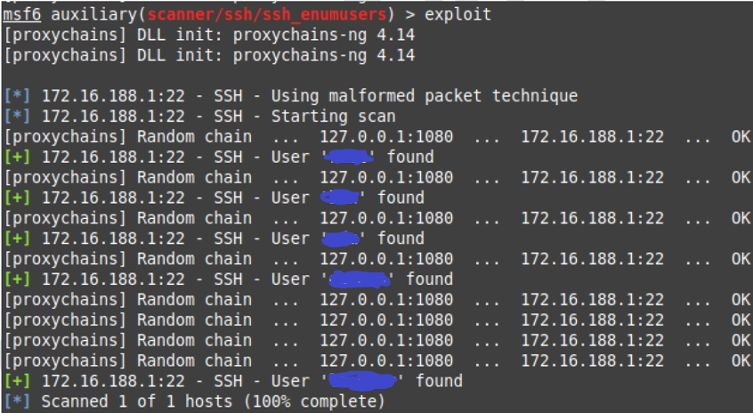
Initial Access (SSH Username Enumeration)
Notes:
I strongly discourage use of Metasploit, however it does have a few good use cases such as SSH user enumeration and approaching Squid proxy servers to enumerate internal hosts. In this case Metasploit was being routed to the internal network via SOCKS5 proxy. It is possible to invoke this with use of Proxychains and having an active dynamic SSH tunnel running so that Metasploit can reach any target hosts.

Slide 8
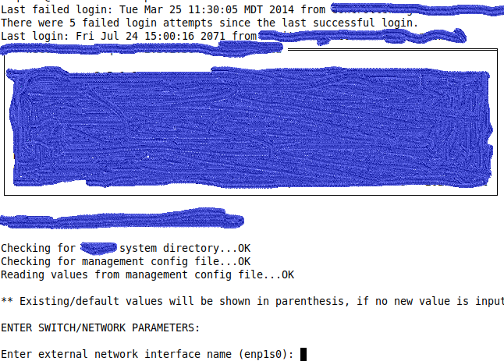
Initial Access (Shell Script)
Notes:
This shell script was designed to login to the target environment and configure networking based settings which led to an automatic logout of the system. This was a clear indication that this account was not intended for regular use since this is a black box technology designed to keep users out other than those with authorisation to configure the system.

Slide 9
Defence Evasion
An account has been found and access has been gained however a user shell is required.
To evade the restricting shell script, the use of a pseudo terminal via SSH was used to launch a bash shell before the shell script could block login attempts.
This step of defence evasion resulted in user based shell access to the target machine.

Slide 10
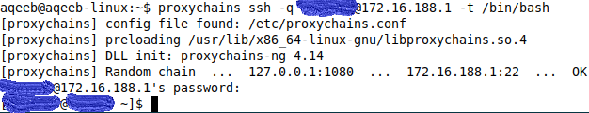
Defence Evasion (Bypassing with Pseudo Terminal in SSH)

Slide 11
Privilege Escalation
During the privilege escalation phase, enabled SUIDs and versions were checked resulting in finding a vulnerable version of Sudo.
The Sudo version was tested for the heap overflow exploit CVE-2021-3156 resulting positive.
A public exploit was found and executed resulting in root access to the target file system.

Slide 12
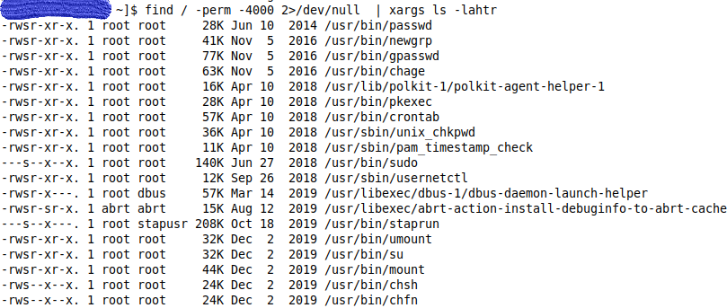
Privilege Escalation (Finding SUIDs)
Notes:
SUIDs are binaries which give you root access in a sandbox environment (Access you can’t use outside of the binary). However, SUIDs can have vulnerabilities and public exploits available which allow the use of exploiting installed SUIDs depending on their version.

Slide 13
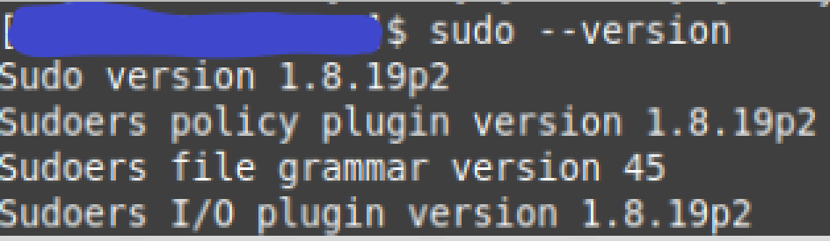
Privilege Escalation (Sudo Version)
Notes:
The version of sudo was identified locally on the machine, which was found to be vulnerable to CVE-2021-3156, a public exploit was identified for this exact version of sudo and executed on this machine as a form of local privilege escalation.

Slide 14
Privilege Escalation (Sudo Exploit Test)
Notes:
The version of sudo was identified locally on the machine, which was found to be vulnerable to CVE-2021-3156, a public exploit was identified for this exact version of sudo and executed on this machine as a form of local privilege escalation.

Slide 15
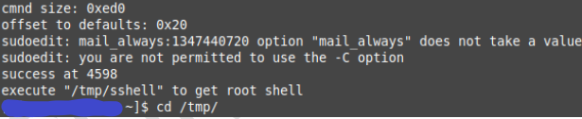
Privilege Escalation (Sudo Exploit)
Notes:
The version of sudo was identified locally on the machine, which was found to be vulnerable to CVE-2021-3156, a public exploit was identified for this exact version of sudo and executed on this machine as a form of local privilege escalation.

Slide 16
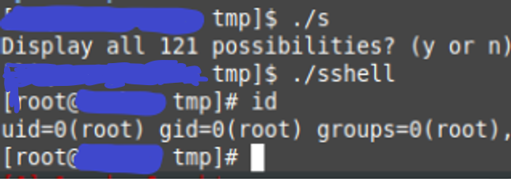
Privilege Escalation (Root Shell)
Notes:
The version of sudo was identified locally on the machine, which was found to be vulnerable to CVE-2021-3156, a public exploit was identified for this exact version of sudo and executed on this machine as a form of local privilege escalation.

Slide 17
Post-Exploitation
Now that root access was achieved, it was time to conduct further searches on the previously restricted shares of the filesystem such as root and other areas.
The purpose of post-exploitation involved credential harvesting of plain-text and hashed passwords such as /etc/shadow and any credentials stored on the target filesystem
Post-exploitation also involved capture of closed source assets such as internal applications and source code of kernel.
Notes:
As a result of having root access, access was gained to internal closed source applications which could be copied entirely, exfiltrated from the system and sold as Trojan Horse viruses to perform initial access into other organisation networks or personal financial gain.

Slide 18
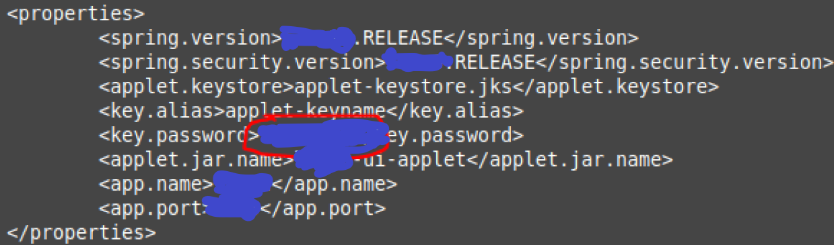
Post-Exploitation (API Password)
Notes:
The version of sudo was identified locally on the machine, which was found to be vulnerable to CVE-2021-3156, a public exploit was identified for this exact version of sudo and executed on this machine as a form of local privilege escalation.

Slide 19
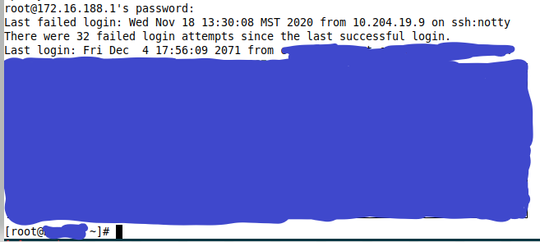
Post-Exploitation (Password Re-use – Root Login)
Notes:
The API password was used to login to the system allowing successful login. Information has been heavily redacted to protect the privacy of the client.

Slide 20
Post-Exploitation (Password Cracking Wordlist Size – Root Login)
Number of Words

Slide 21
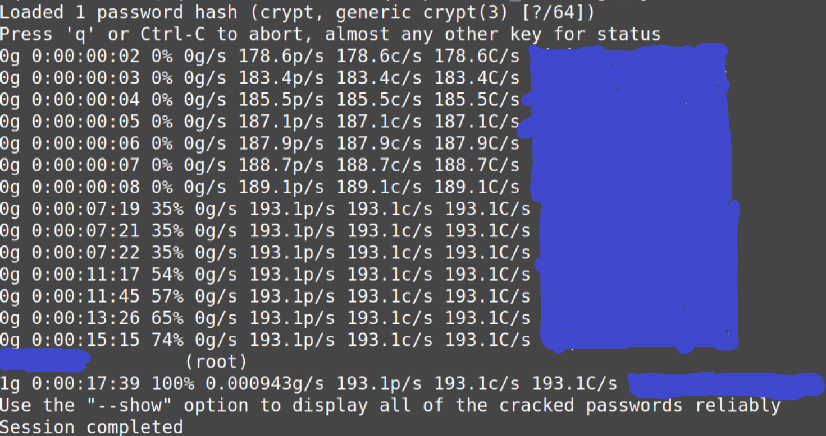
Post-Exploitation (Password Cracking)
Cracking time: 17:39

Slide 22
Lessons Learnt
Never keep default credentials available after installation of equipment, change them immediately.
Patch all installed packages which contain known vulnerabilities with available public exploits, do not make privilege escalation a simple step.
DO NOT re-use credentials for shell access, make a strong root password following the NCSC advice of 3 random words combined with special characters.
DO NOT use guessable passwords based on common patterns and known words.
Notes:
Lessons learnt from this penetration test and what you should follow for your organisation.

Slide 23
Reporting
A penetration test should be treated with the utmost of sensitivity when handling information which means redacting organisation name when mentioning said test in other scenarios (Training, interviews, meetings)
A report should be encrypted in the form of a .docx or PDF with a strong password ONLY given to the point of contact from the organisation.
Upon delivery of report, a summary should be given of steps taken, objectives achieved in addition to a separate email for the password of the encrypted document.
Notes:
Guidelines which should be followed in the event of any security vulnerability being discovered, penetration testing or red team engagement. Anything which involves sensitive information, names of third party clients or vulnerable environments should be handled with care when delivering information to ensure information has been handled as securely as possible.

Slide 24

Questions?

Slide 25

And that’s the end! Thank you all!
Instructor: Aqeeb Hussain
GitHub: https://github.com/aqeebhussain122/hpc-offensive-security

Slide 26

The End
Notes:
I hope you learnt something valuable from this training course, thank you!

